Slide 1

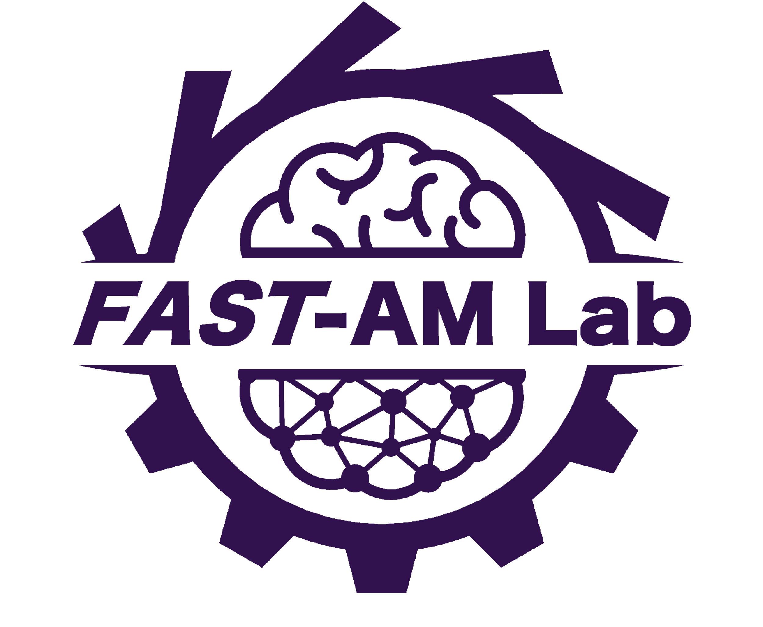

in collaboration with

Slide 2
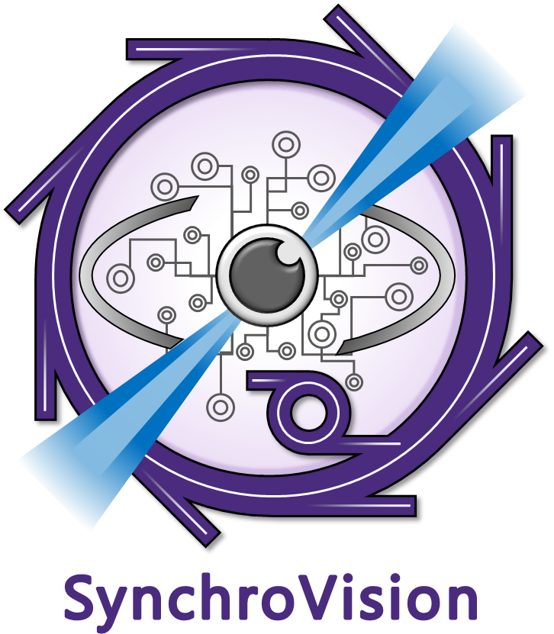

An end-to-end machine learning powered x-ray image analysis software
Developed by
in collaboration with

